Slide 1
University Physics IA PHYS 1001A (Spring)
Time: 10:30 am – 12:15 am or 2:00 pm – 3:45 pm
Weeks 1–16 (Mar. 09, 2026 – Jun. 26, 2026)
Place: T3-401
Instructor: Fei YEN (晏飞翔)
Office: Campus’ Starbucks or sometimes at G-403A
Email: fyen@hit.edu.cn
Phone: 1343-058-9183

Slide 2
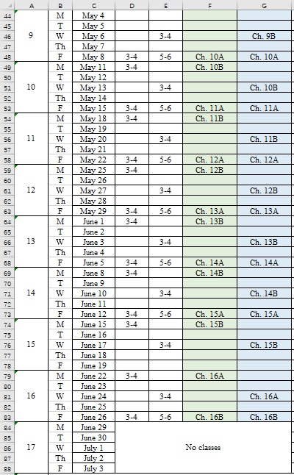
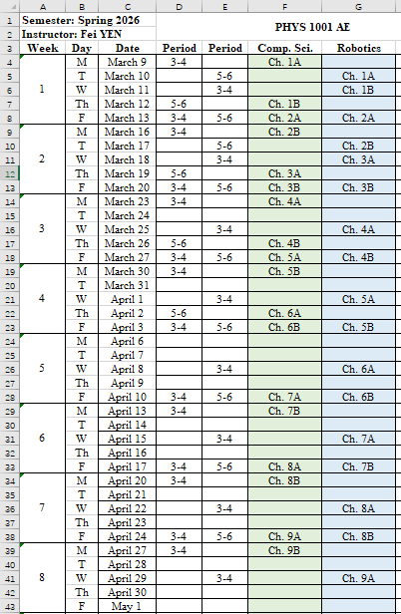
Schedule of the course
Period 3-4: 10:30 – 12:15
Period 5-6: 14:00 – 15:45

Slide 3
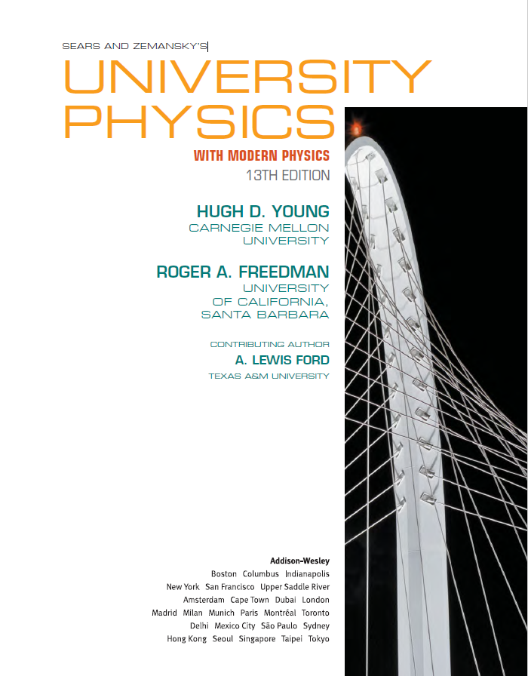
Book:
https://www.andrew.cmu.edu/user/bbji/Desktop/University%2520Physics%2520with%2520Modern%2520Physics%252015th%2520Edition%2520By%2520Hugh%2520D.%2520Young_compressed.pdf&ved=2ahUKEwiP862CmpCTAxX2_gIHHe1bDbMQFnoECBoQAQ&usg=AOvVaw09jCutPhiHPB6V0_lfIEz-

Slide 4
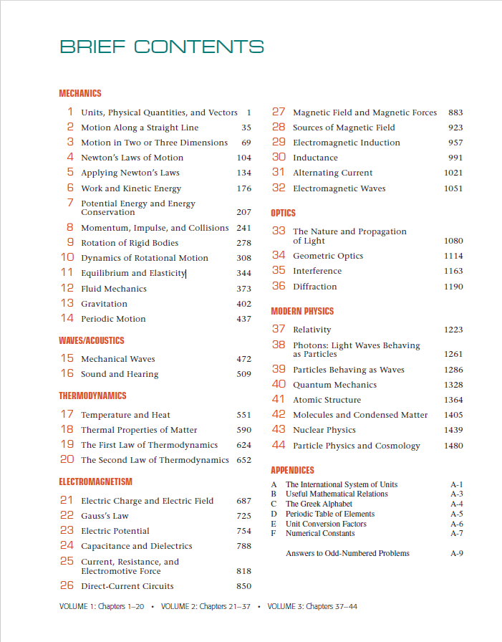
Ch. 1 – Ch. 14
Ch. 21 – Ch. 24

Slide 5
Class structure
Lecture: 40 – 45 minutes;
5-minute break;
Recitation session: 20 – 50 minutes;
Go over problems at the end of each chapter
Answer questions from previous HW assignments
Quiz: 30 minutes (why?).
Visual learning (25%);
Auditory learning (5%);
Kinesthetic learning (70%);

Slide 6
Grading
14-16 sets of homework and 15-16 quizzes, 20%;
1 mid-term, 30%;
Closed book
Ch. 1 – Ch. 11 or Ch. 12
Final 50%;
Closed book
Non-comprehensive

Slide 7
Attendance
Undergraduate students: attendance rate must be +80%
QR codes will be available at
the beginning of the class,
during the mid-session break and
end of class.
If you can’t make it to class, email me and I will check you off internally.
If you have problems scanning the QR code, take a screenshot of the message and go to H719 for assistance.

Slide 8
Personal goals for the course
For students to enjoy physics;
Build confidence;
Make sure students understand everything.

Slide 9
How to get a good grade
Come to class and take notes;
Do the homework problems;
Review after class (15 to 30 minutes);
Study in advance (15 to 30 minutes);
Ask questions if you don’t understand something.

